Slide 1


Predicted Delivery Insights
Domain- Ecommerce
By- Jagan sahu

Slide 2

Content
Context
Problem Statement
Dataset Description
Features
Importing Libraries
Data preprocessing
Exploratory Data Analysis
Model Building
Logistic Regression
Decision Tree
Ada Boost
Random Forest

Slide 3

Context
In an era of heightened customer expectations and rapid online shopping growth, the "Predicting Delivery Timing Insights" project emerges as a crucial endeavor. This project centers on harnessing data analytics and AI-driven models to forecast precise delivery times. It addresses the challenges faced by industries reliant on efficient deliveries, such as e-commerce and logistics, striving to reduce delays, optimize routes, and enhance customer satisfaction. By leveraging historical data and real-time information, this project aims to revolutionize delivery accuracy and efficiency in a competitive marketplace.

Slide 4

Problem Statement
The primary objective of this study is to employ a range of features and attributes to predict with precision whether a product will be delivered on time. Such accurate delivery time predictions are instrumental in enabling businesses to devise effective strategies and enhance their operational efficiency.
This is Supervised machine learning classification problem.
Number of Instances: 10,999
Number of Attributes: 11

Slide 5

Dataset Description
This dataset features essential attributes related to product delivery. This dataset comprises various attributes related to product delivery and customer interactions. This dataset is valuable for analyzing factors affecting delivery punctuality, customer satisfaction, and optimizing business operations. The data includes categorical and numerical variables, making it suitable for predictive modeling and insights generation. The primary goal of this dataset is to facilitate predictive modeling and analysis to gain insights into factors impacting delivery timeliness.

Slide 6

Features
Warehouse block
Mode of Shipment
Customer care calls
Customer rating
Cost of the Product
Prior purchases
Product importance
Gender
Discount offered
Weight in gms
Reached on Time Y.N

Slide 7
Importing libraries

Slide 8
Data Assessment
Following functions are used:
Data shape
Describe
Info
Isnull.sum
Value counts

Slide 9
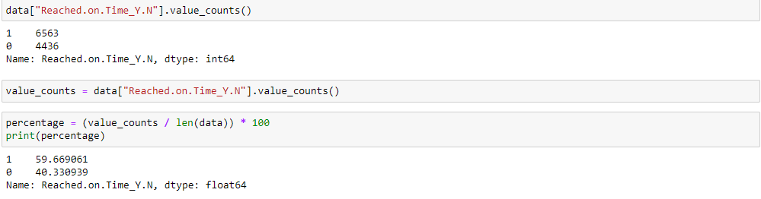
Data Assessment
Target variable contains 60% values that indicates the product was not on time and 40% that indicates it was on time.

Slide 10
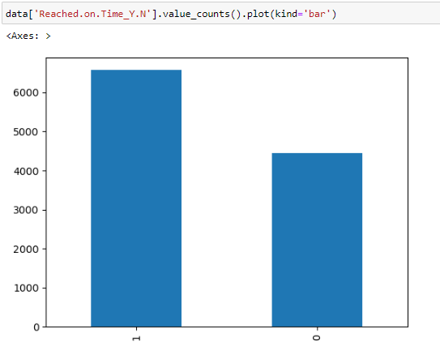
Data Assessment

Slide 11
EDA
Exploratory Data Analysis is the process of summarizing, visualizing, and understanding data to uncover patterns, relationships, and insights before conducting more in-depth analysis or modeling.
Correlation Analysis
Shipment and Timeliness Relationship
Feature Engineering
Warehouse Block, Shipment Mode and Product Importance Distribution

Slide 12
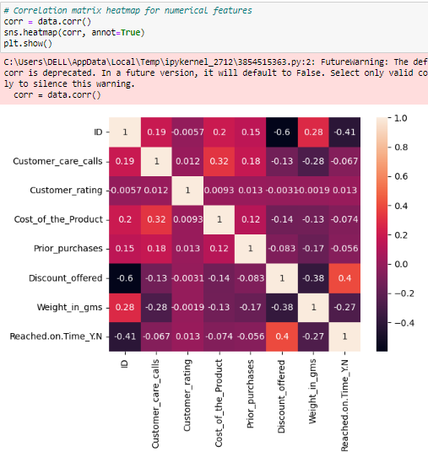
EDA
I have initially performed a correlation analysis by creating a heatmap to visualize the relationships between numerical features, helping in identify potential patterns or dependencies.

Slide 13
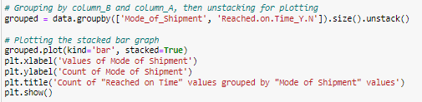
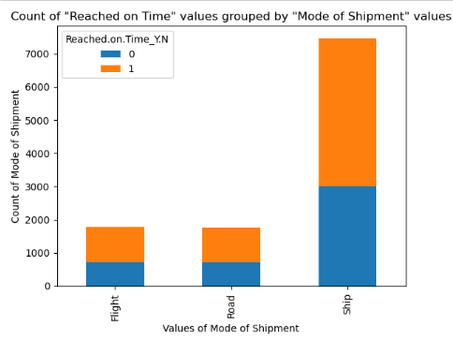
I explored how different modes of shipment impact delivery timeliness by creating a stacked bar chart that showed the distribution of "Reached on Time" values based on the chosen shipment method.

Slide 14
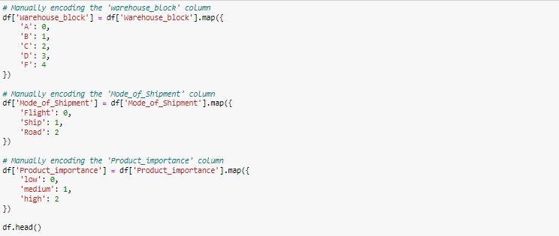
To prepare the data for modeling, I have conducted feature engineering. This involved dropping unnecessary columns and manually encoding categorical variables such as "Warehouse_block," "Mode_of_Shipment," and "Product_importance" into numerical representations.

Slide 15
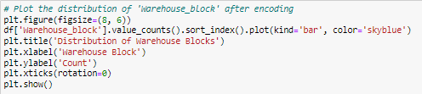
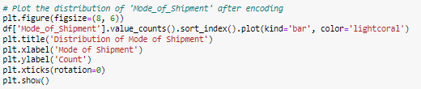
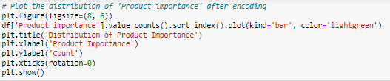
We visualized the distribution of warehouse blocks after encoding, providing insights into the allocation of products across different warehouse sections. We also visualized the distribution of shipment modes and product importance levels after encoding, shedding light on their prevalence in the dataset.
Here I have attached the codes and in the below slides the visualization has been attached for better understanding of the codes.

Slide 16
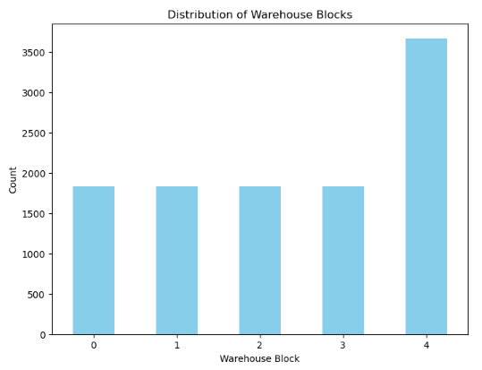
Distribution of Warehouse Blocks

Slide 17
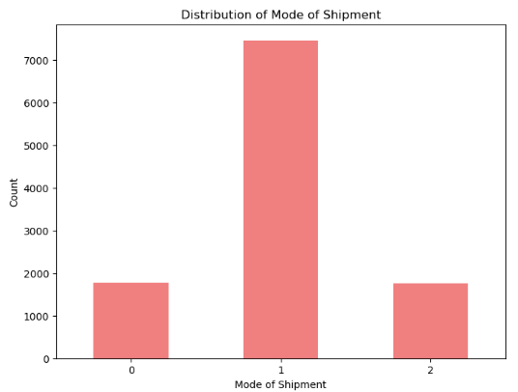
Distribution of Mode of Shipment

Slide 18
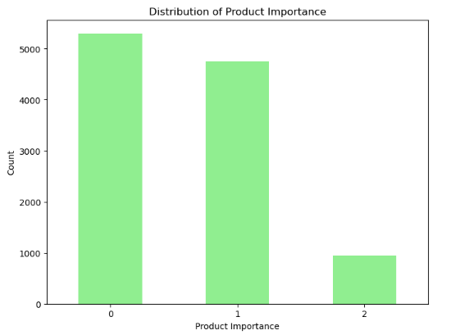
Distribution of Product Importance

Slide 19
Key Performance Indicator
Accuracy: provides an overall view of correctness in predictions.(TP + TN) / (TP + TN + FP + FN)
Precision: The proportion of correctly predicted positive instances (true positives) out of all instances predicted as positive (true positives + false positives). TP / (TP + FP)
Recall: The proportion of correctly predicted positive instances (true positives) out of all actual positive instances (true positives + false negatives). TP / (TP + FN)
F1-score: The harmonic mean of precision and recall. It balances the trade-off between precision and recall. 2 * (Precision * Recall) / (Precision + Recall)

Slide 20
Model Building
Model building in machine learning (ML) involves the process of selecting and creating a suitable algorithm or mathematical representation that can learn from data to make predictions, classifications, or other decisions.
Following mentioned methods are used:
Logistic Regression
Decision Tree
Ada Boost
Random Forest

Slide 21

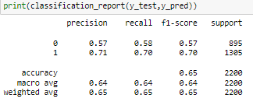

Logistic Regression
Logistic Regression is a statistical technique used for binary classification problems, where the goal is to predict the probability that an instance belongs to a particular class (usually labeled as 0 or 1).

Slide 22


Decision Tree
A Decision Tree is a supervised machine learning algorithm used for both classification and regression tasks. It's a simple yet powerful method that makes decisions by asking a series of questions based on the features of the input data, leading to a predicted class label (in classification) or a continuous output value (in regression).

Slide 23

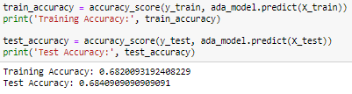
Ada Boost
AdaBoost is an ensemble learning method in machine learning that combines multiple weak classifiers to create a strong classifier. It assigns weights to misclassified data points in each iteration, allowing subsequent classifiers to focus more on the previously misclassified samples, ultimately improving the overall model's performance.

Slide 24

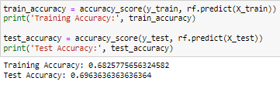
Random Forest
A Random Forest is an ensemble learning method using decision tree in a randomized way .Random Forests are widely used in practice due to their excellent predictive performance, simplicity of use, and the ability to handle a variety of data types and complexities.

Slide 25
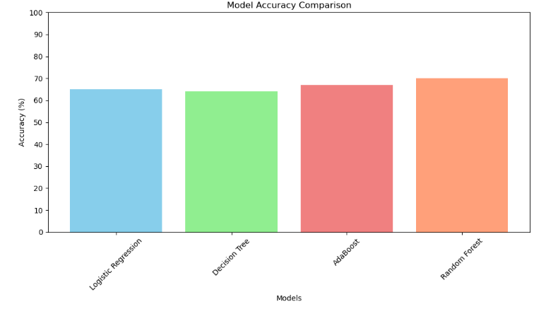
Best Outcome
Decision Tree :
Training Accuracy: 1.0%
Testing Accuracy: 0.65%
Confusion Matrix:
728 | 592
587 | 1393
 | Accuracy
Logistic Regression | 0.65
Decision Tree | 0.64
Ada Boost | 0.67
Random Forest | 0.70

Slide 26
Conclusion
In an age marked by elevated customer expectations and the rapid growth of online shopping, the 'Predicting Delivery Timing Insights' initiative emerges as a pivotal undertaking. This project focalizes on harnessing data analytics and AI models to predict delivery times with precision, addressing the challenges faced by industries reliant on efficient deliveries, such as e-commerce. The utilization of historical and real-time data is poised to revolutionize delivery accuracy and operational efficiency within a fiercely competitive marketplace. The dataset, featuring 10,999 instances and 11 attributes, provides a wealth of information on product delivery and customer interactions, presenting a valuable opportunity for analyzing factors affecting delivery punctuality, enhancing customer satisfaction, and optimizing business processes.

Slide 27


